Slide 1
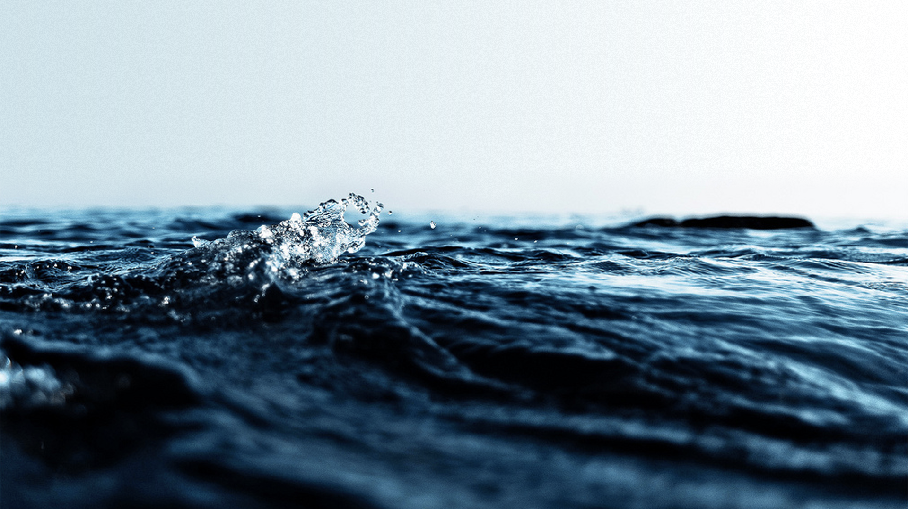
Why useful? Background Satellite products and sensors
Surface Ocean: Remote Sensing

Slide 2
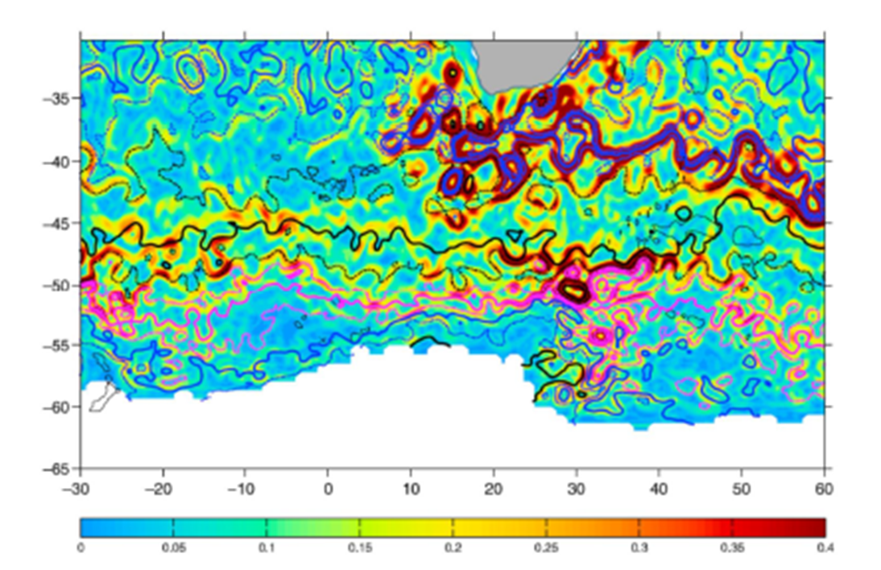
WHY IS REMOTELY SENSED DATA USEFUL TO OCEANOGRAPHERS???
Ocean circulation is neither smooth nor steady but chaotic and changing rapidly in space and time
eg. A typical SSH gradient field
south of Africa
Observing this ocean variability from ships or buoys would be very difficult and costly
Therefore satellites provide the means to sample the ocean at a high frequency on a global scale – impossible to achieve this using in situ observations
2.

Slide 3
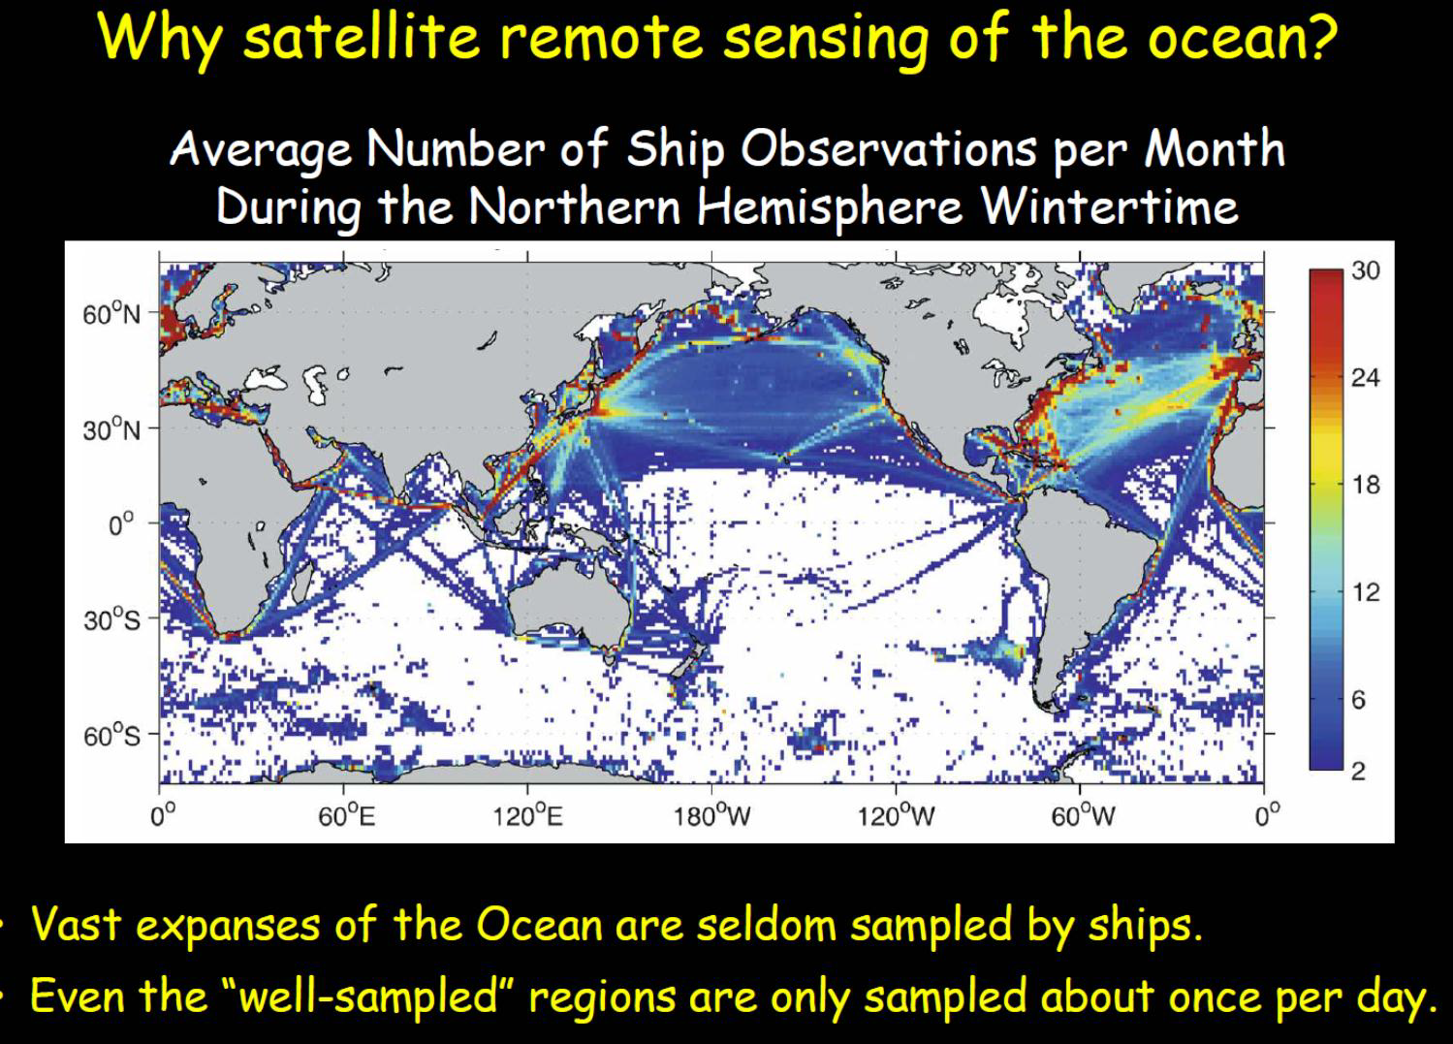

Slide 4
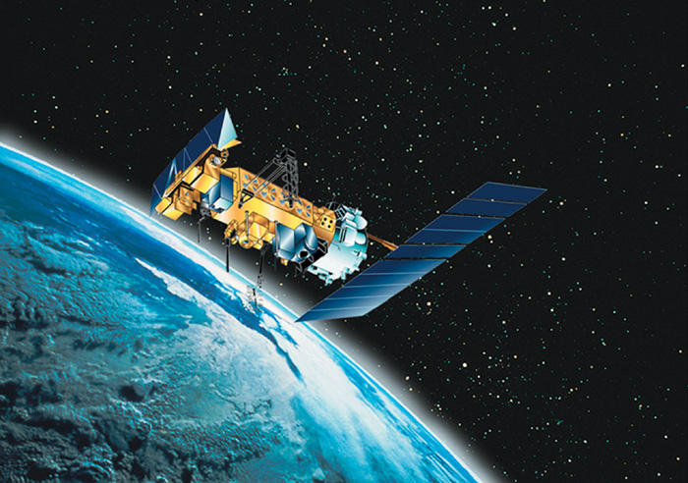
So…
Sensing the Earth from afar provides us with a unique perspective of our planet i.e. global picture, but we can also have access to more detailed images of the Earth (with increasing resolution of sensors).
Ship based research is small scale – satellites can cover global scale! Scientists are able to see phenomenon otherwise not visible to us.
From high above, we receive wide views of surface temperatures, currents, salinity, plankton blooms, winds and even the movements of large sea creatures!
2.

Slide 5
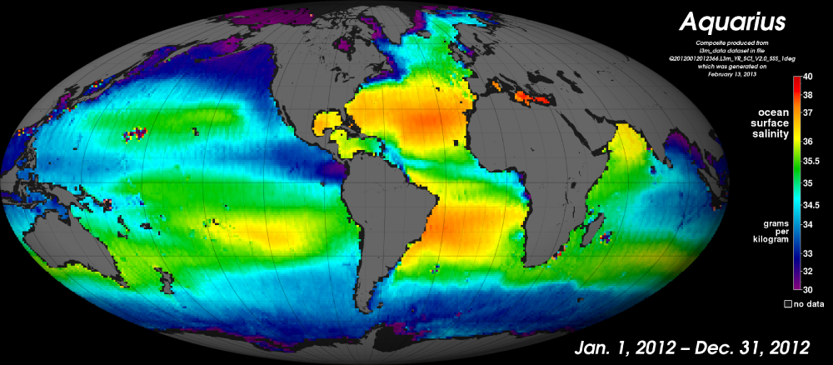
What are the limitations ?
Must measure through intervening atmosphere → Satellite observations are more sensitive to unfavourable meteorological conditions (i.e. cloud) than traditional oceanographic methods.
The parameters measured by the satellites cannot be directly attributed to traditionally measured oceanographic characteristics. NO DEPTH!
Space is a harsh environment for acquiring measurements
Cost – Satellites are also expensive
Risk – If satellites fail, service calls are even more expensive
Some parameters are very difficult to measure. Eg. Salinity only since 2011!
3.

Slide 6
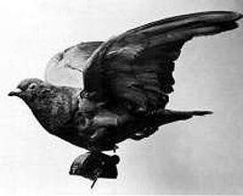
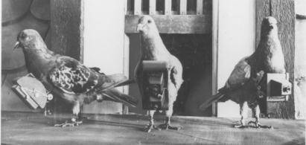
Background: Remote sensing pioneers
In 1903, Julius Neubranner, photography enthusiast, designed and patented a breast-mounted aerial camera for carrier pigeons
Weighing only 70 grams the camera took automatic exposures at 30-second intervals along the flight line flown by a pigeon.
Although faster than balloons they were not always reliable in following their flight paths.
3.

Slide 7
What satellite products are oceanographers interested in?
Sea Surface Temperatures (SST)
Currents
Wind and Waves
Ocean Variability – i.e. eddies, meanders
Ocean colour (productivity)
4.

Slide 8
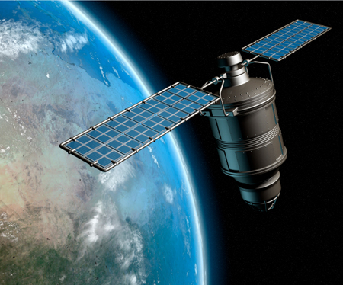
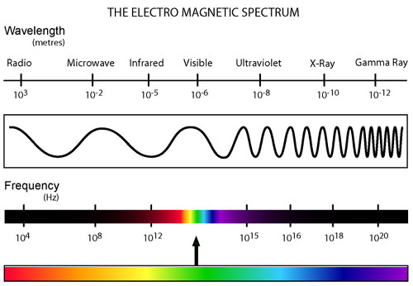
Remote Sensing via Satellites
1. Definition
All sensors employed on ocean-observing satellites use electromagnetic (EM) radiation to view the sea. The source varies depending on the sensor characteristics:
5.

Slide 9
Remote Sensing via Satellites
Most systems rely on the sun to generate EM energy needed to image ocean surfaces. These systems are called passive sensors.
Only works when the target is illuminated by the sun, thus limiting visible light sensors on satellites from being used during a night time pass.
The amount of solar radiation present at polar latitudes is often insufficient for visible light sensors, limiting the use of passive detectors to lower latitudes.
Clouds, dust, smoke, and other particles in the atmosphere can block reflected energy from reaching a sensor.
Other sensors generate their own EM energy, called active sensors, transmits that energy in a certain direction and record the portion reflected back by features within the signal path, i.e. radar.
5.

Slide 10
Remote Sensing via Satellites
Passive Sensors
Active Sensors
Visible waveband sensors
Infra-red sensors
Microwave sensors
Radar instruments
Sensor class
Multi-spectral scanners
Imaging spectrometers
Infra-red imaging radiometers
Scanning microwave radiometers
Scatterometer
Imaging radar
Altimeter
Sensor type
Primary measure
Ocean colour
Sea Surface Temperature
Surface roughness
Surface height/slope
Chlorophyll
Suspended particulates
Bathymetry
Surface winds
Wave height
Wave spectra
Internal waves
Surface slicks
Geostrophic currents
Ocean geoid
Sea-floor bathymetry
Derived parameters
Mixed-layer temperature
Skin temperature
6.

Slide 11
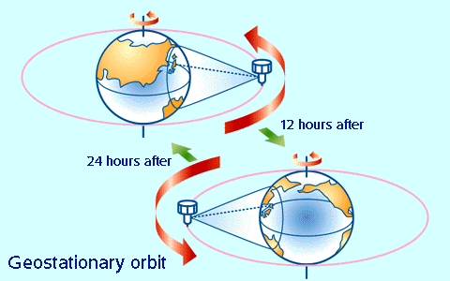
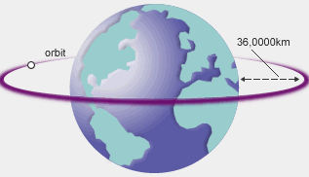
Types of Satellite Orbits
1. Geostationary Satellites
A geostationary orbit is a circular orbit 35,800 kilometres above the Earth's equator following the direction of the Earth's rotation
(the satellite’s period equal the Earth’s rotation period)
This means that they observe the Earth from the exact same place (Lagrangian tool) all the time. This allows the geostationary satellites to continuously monitor a single position on the earth's surface.
Geostationary satellites provide half-hourly observations of the Earth and its environment.
7.

Slide 12
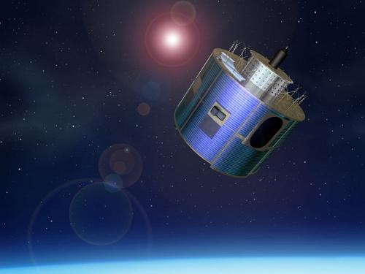
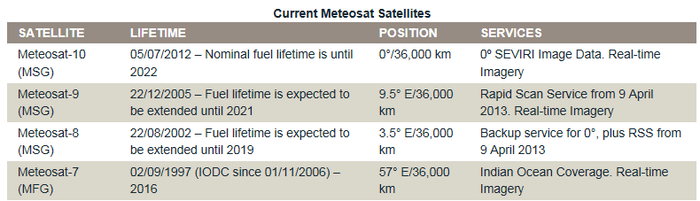
Types of Satellite Orbits
1. Geostationary Satellites
Example of geostationary satellites:
The Meteosat satellites — Meteosat-7, -8, -9 and -10 — operate over Europe and Africa. Meteosat-10 (launched on 2012) is the prime operational geostationary satellite and providing full disc imagery every 15 minutes.
Meteosat-9 (launched on 2005) provides the Rapid Scanning Service, delivering more frequent images every five minutes over parts of Europe, Africa and adjacent seas.
Meteosat Second Generation (MSG)
8.

Slide 13
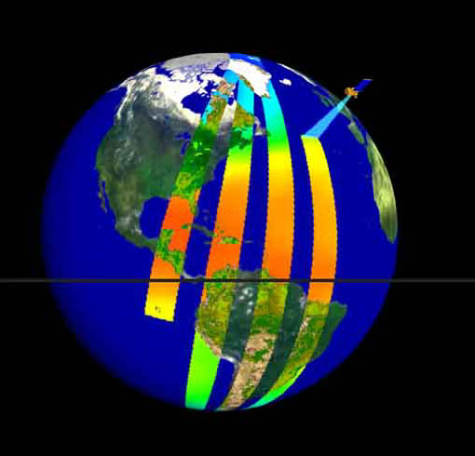
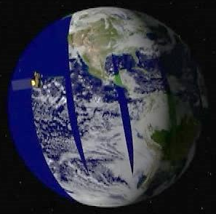
Types of Satellite Orbits
2. Polar Orbit Satellites
Polar orbit satellite pass above or nearly above both poles on each revolution. Such satellite will pass over the equator at different longitude on each of its orbits. It orbits about 850 km above the Earth's surface.
The orbital period is about 98 to 102 minutes.
These satellites have meteorological and geophysical importance because of their high-resolution global coverage.
Here is a YouTube video that explains both the geostationary and polar orbit satellites:
http://www.youtube.com/watch?v=E4k3kEA3pmo
9.

Slide 14
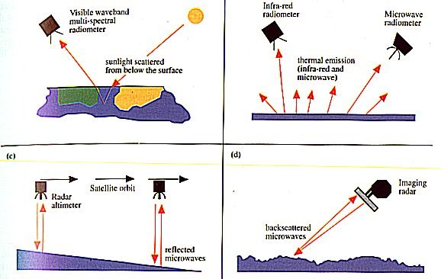
Properties Measured by Satellites
1. Sea Surface Temperature
How to measure SST with satellites?
Satellites carry instruments that detect electromagnetic radiation. These instruments are designed to measure the infrared part of the electromagnetic spectrum (thermal radiation emitted by the sea surface).
All terrestrial objects (blackbody) emit thermal radiation, depending on its own temperature: higher temperature objects produce shorter wavelengths of radiation.
10.

Slide 15
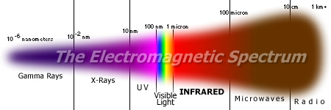
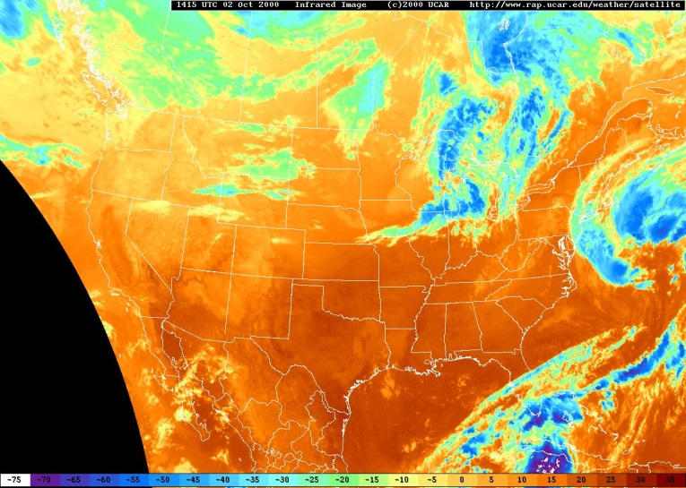
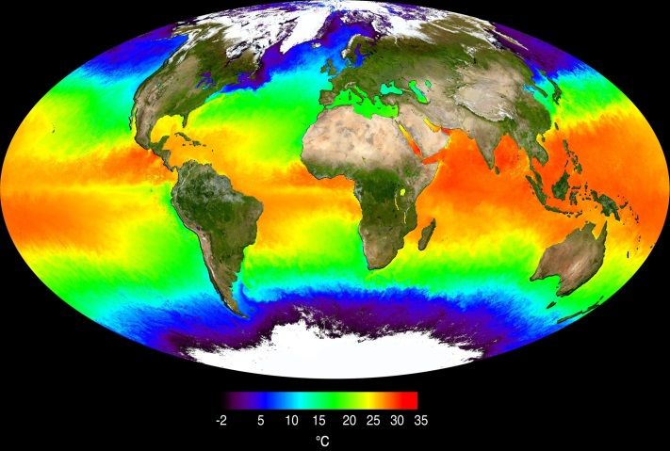
Properties Measured by Satellites
1. Sea Surface Temperature
How to measure SST with satellites?
Image deduced from infrared radiation.
The satellite-measured SST provides both a synoptic view of the ocean and a high frequency of repeat views, allowing the examination of basin-wide upper ocean dynamics not possible with ships or buoys.
11.

Slide 16
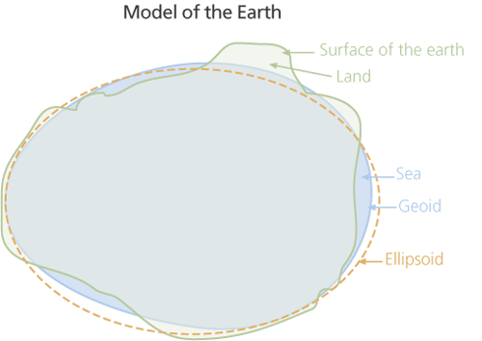
Properties Measured by Satellites
2. Sea Surface Height
Vocabulary check-up:
Geoid: The equipotential surface of the Earth's gravity field which best fits to the global mean sea level (MSL) and is the zero surface as defined by the Earth's gravity.
Ellipsoid: has the nature or shape of an ellipsoid represent the geometric model of the Earth. This reference ellipsoid is a raw approximation of Earth's surface, a sphere flattened at the poles. The satellite altitude above the reference ellipsoid, distance S, is available to within 3 cm.
17.

Slide 17
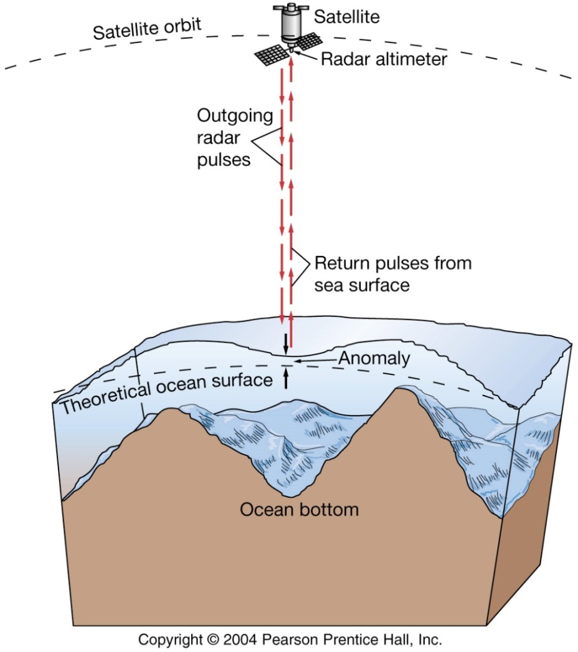
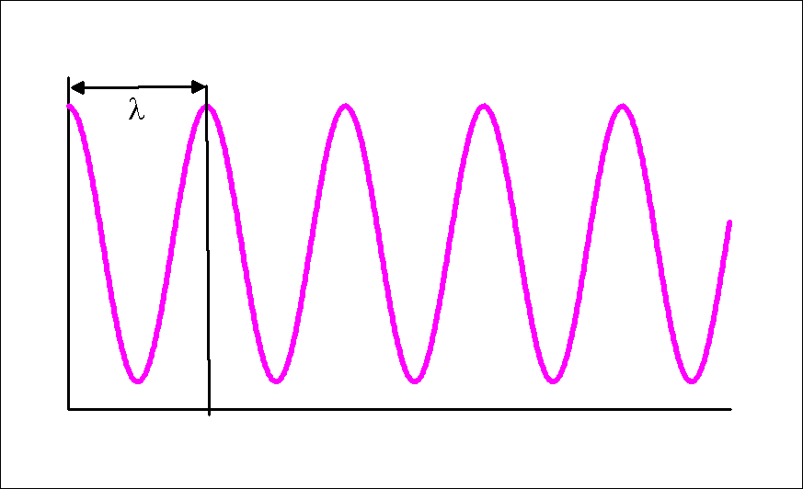
Properties Measured by Satellites
2. Sea Surface Height
Basic principles of satellite altimetry
Radar altimeters on board the satellite permanently transmit signals at high frequency (>1700 pulses per second) to Earth
Receiving the echo signal from the sea surface, the sensor measures not only the amplitude but also the phase of the reflected signal and the travel time of the pulse (round-trip time between the satellite and the sea surface).
Measuring the phase of the reflected signal reflected enables measuring the travel time with very high accuracy.
18.

Slide 18
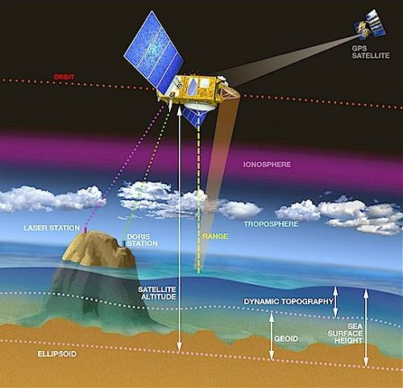
Properties Measured by Satellites
2. Sea Surface Height
Basic principles of satellite altimetry
The Sea Surface Height (SSH), is the range at a given instant from the sea surface to a reference ellipsoid. The sea level is simply the difference between the satellite height S and the altimetric range R:
SSH = S – R
The SSH depends on 5 factors: geoid, ocean tides, atmospheric pressure, geostrophic circulation and ocean waves.
19.

Slide 19
Properties Measured by Satellites
2. Sea Surface Height
Basic principles of satellite altimetry
The final SSH value takes account of such effects as:
The sea surface height which would exist without any disturbances (wind, currents, tides, etc.).
The surface called the geoid, which is due to gravity variations around the world, which are in turn due to major mass and density differences on the seafloor.
The ocean circulation, or dynamic topography. This comprises of a permanent stationary component (permanent circulation linked to Earth's rotation, permanent winds, etc.) and a highly variable component (due to wind, seasonal variations, etc.).
20.

Slide 20
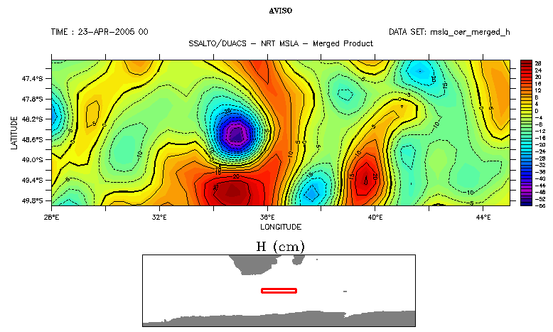
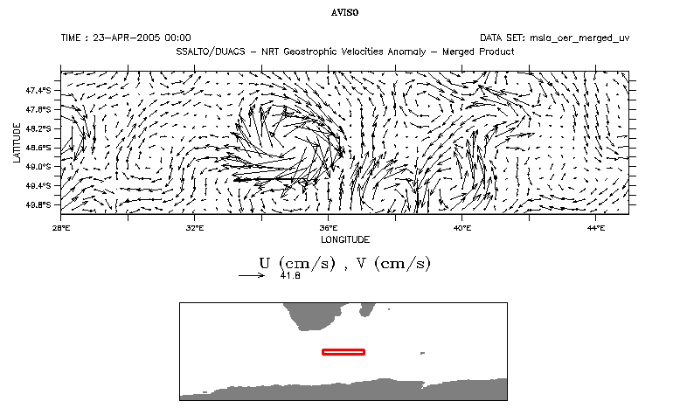
Properties Measured by Satellites
2. Sea Surface Height
What can we deduce from altimetry?
Surface geostrophic currents:
SSH
Geostrophic Velocities
27.

Slide 21
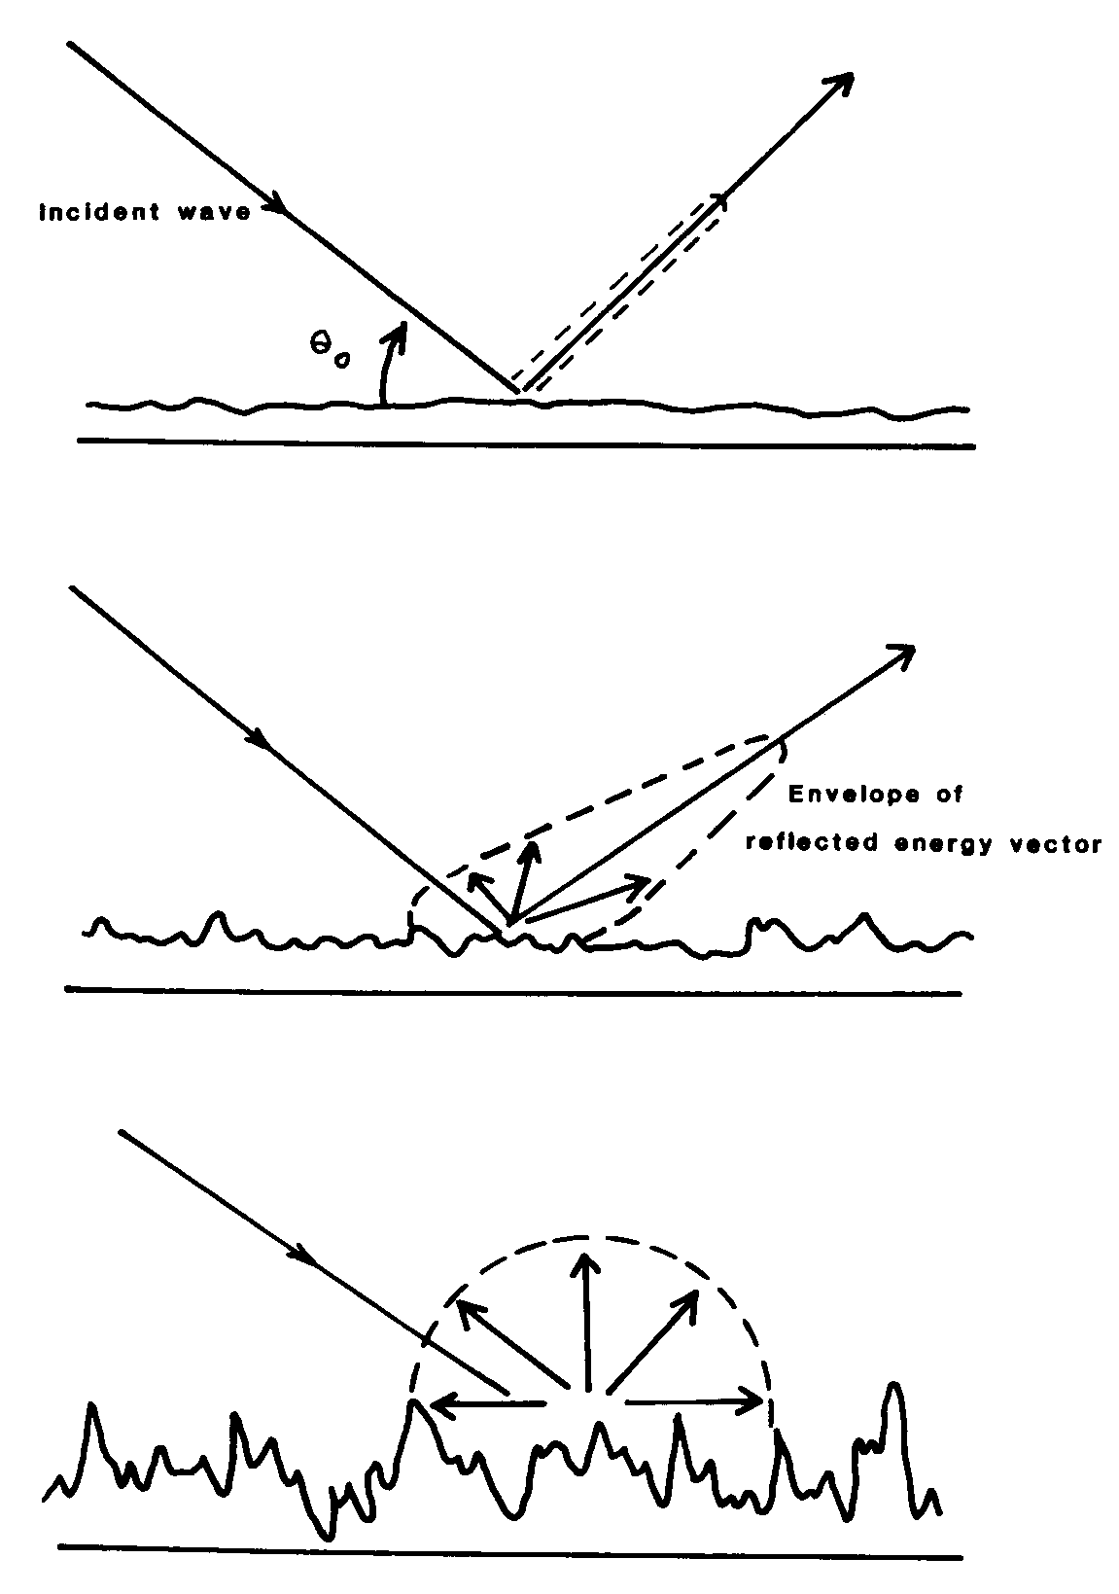
Properties Measured by Satellites
3. Sea Surface Roughness
Basic principles of scatterometer
The shape and intensity of the reflected radar signal depends on the sea state: a calm sea sends the signal back almost perfectly, like a flat mirror, whereas a rough sea scatters and deforms it.
Microwave scatterometer is based on the principle of scattering.
4. Sea Surface Roughness - Oblique-viewing microwave radiometers
28.

Slide 22
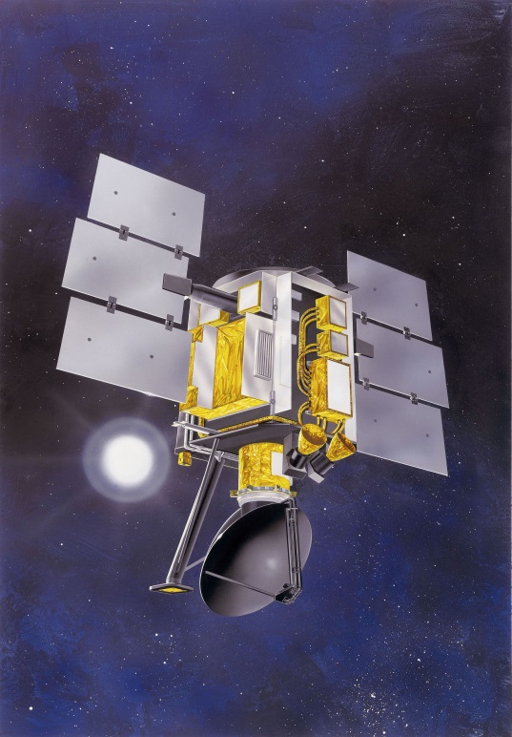
Properties Measured by Satellites
Sea Surface Roughness - Oblique-viewing microwave radiometers
3. Sea Surface Roughness
“Scatterometer” Satellite
Satellite with “scatterometer” sensors illuminate a wider part of the ocean. Wind vectors (wind speed and direction) at 50 km resolution are obtained with a separation of 25 km across a 500 km swath (ERS satellite).
The QuikScat satellite, carrying the SeaWinds scatterometer, was launched in July 1999, replacing the NASA scatterometer (NSCAT), which failed prematurely in June 1997 after 9.5 months in operation.
QuikSCAT, however, far exceeded these design expectations and continued to operate for over a decade!
Its primary mission was to measure the surface wind speed and direction over the ice-free global oceans.
29.

Slide 23
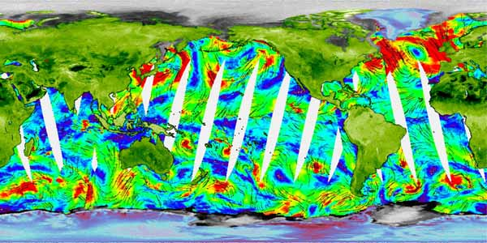
Properties Measured by Satellites
Sea Surface Roughness - Oblique-viewing microwave radiometers
3. Sea Surface Roughness
“Scatterometer” Satellite
Example of wind speed over the ocean surface measured by QuikSCAT scatterometer.
30.

Slide 24
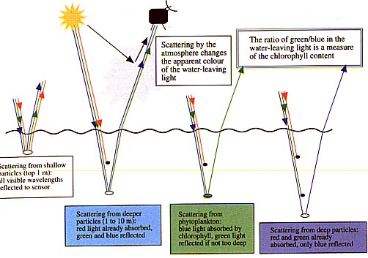
Properties Measured by Satellites
4. Ocean Colour
How do satellites measure the ocean colour ?
Satellites measure the backscattered wavelengths.
40.

Slide 25
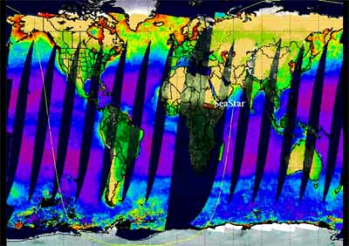
Properties Measured by Satellites
4. Ocean Colour
What are the satellites that measure the ocean colour ?
SeaStar Spacecraft: SeaWiFS
The swaths overlap in high latitudes and are separated in low latitudes. Thus, each location of the ocean is observed every other day.
42.

